Slide 1
Neural Machine Translation with Imbalanced Classes (Ph.D. Qualifier Exam)
Thamme Gowda
tg@isi.edu

Slide 2
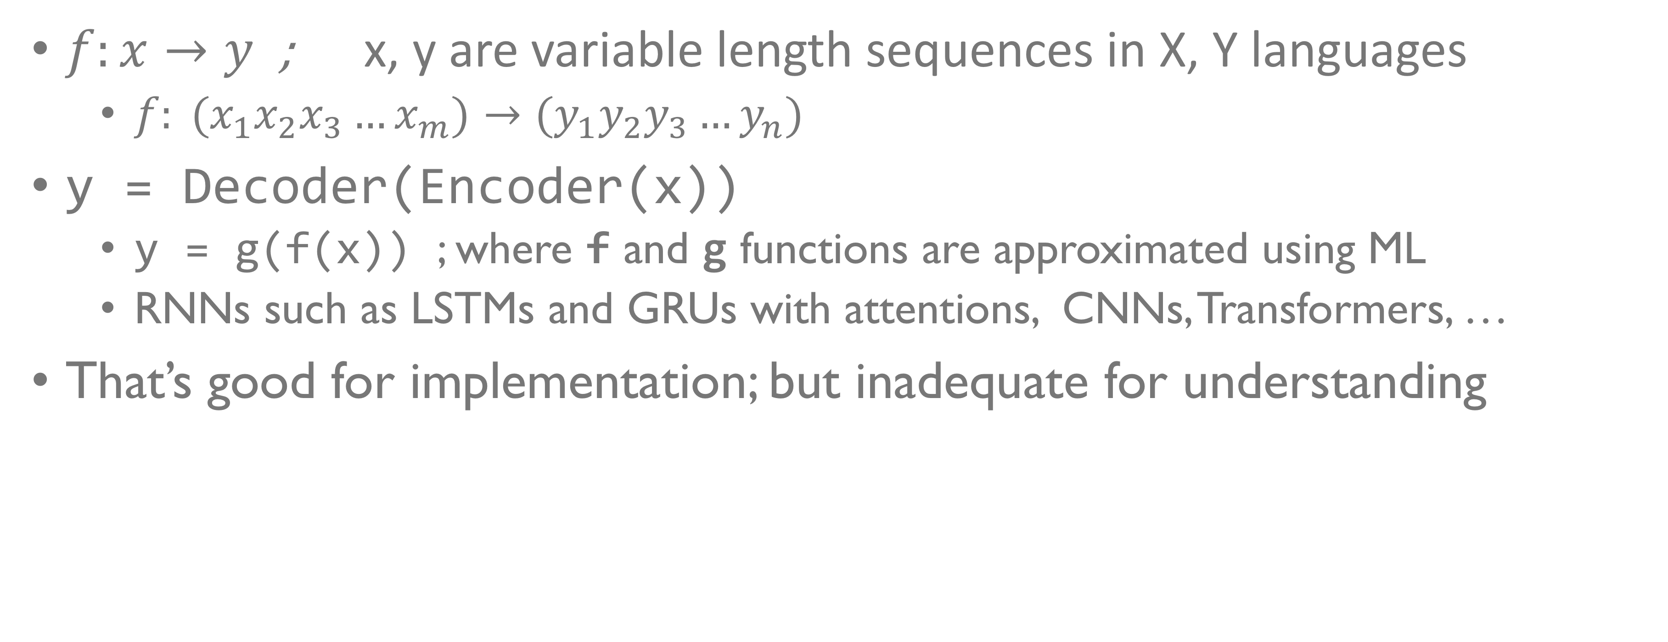
NMT
$f:x→y$ ; x, y are variable length sequences in X, Y languages
$f: (x_{1}x_{2}x_{3}…x_{m})→{(y}_{1}y_{2}y_{3}…y_{n})$
y = Decoder(Encoder(x))
y = g(f(x)) ; where f and g functions are approximated using ML
RNNs such as LSTMs and GRUs with attentions, CNNs, Transformers, …
That’s good for implementation; but inadequate for understanding

Slide 3
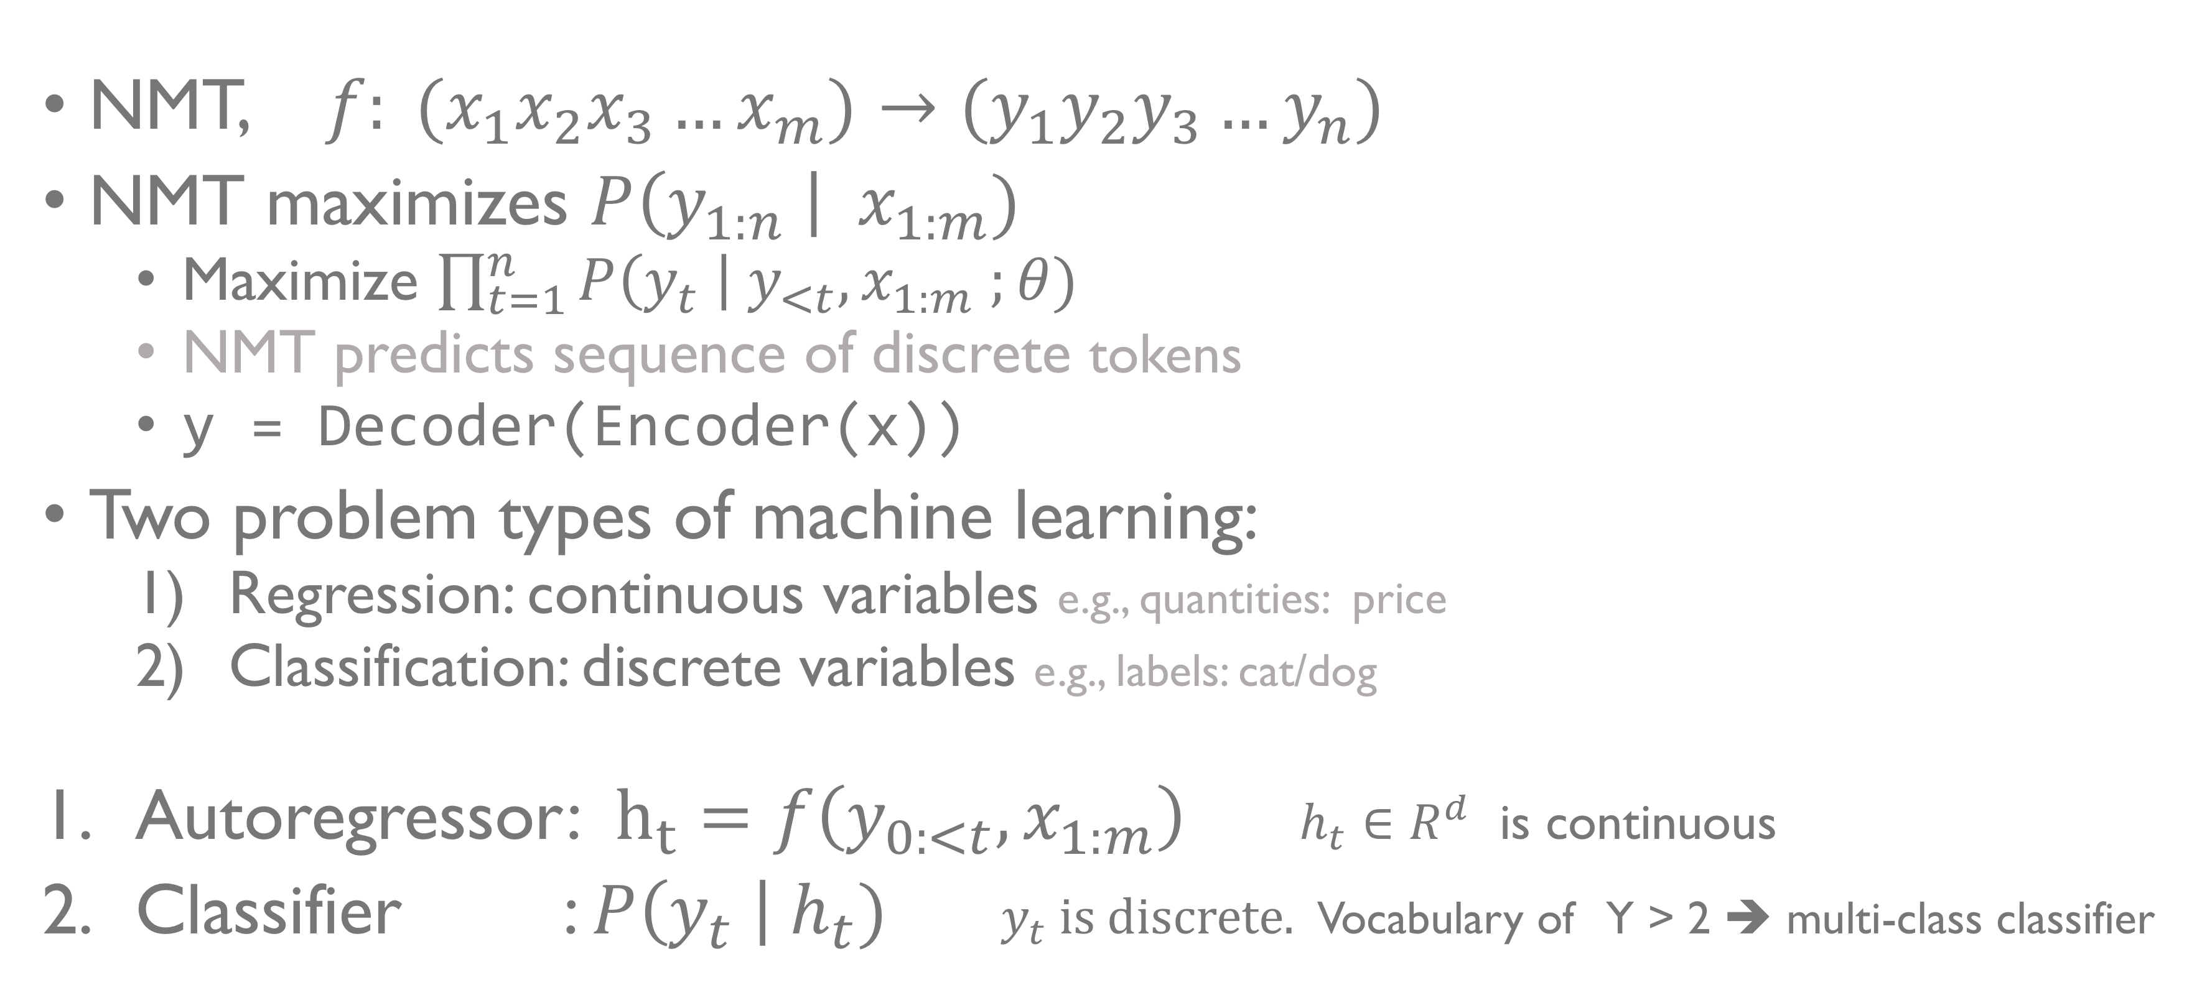
NMT: Abstraction
NMT, $f: (x_{1}x_{2}x_{3}…x_{m})→{(y}_{1}y_{2}y_{3}…y_{n})$
NMT maximizes $P\left(y_{1:n} \right| { x}_{1:m})$
Maximize $\prod_{t=1}^{n}{P\left(y_{t} \right| y_{<t}, x_{1:m} ;θ)}$
NMT predicts sequence of discrete tokens
y = Decoder(Encoder(x))
Two problem types of machine learning:
Regression: continuous variables e.g., quantities: price
Classification: discrete variables e.g., labels: cat/dog
Autoregressor: $h_{t}=f\left(y_{0:<t}, x_{1:m}\right)$ $h_{t}∈R^{d}$ is continuous
Classifier : $P\left(y_{t} \right|{ h}_{t})$ $y_{t}$ is discrete. Vocabulary of Y > 2 ➔ multi-class classifier
Notes:
$y_{o}=[BOS]$; for $t=1, 2… argmax P\left(y_{t}| h_{t}\right)=[EOS]$

Slide 4
Curses of Zipfian Distribution
Unseen Vocabulary ➔Problem-1: Classifiers can model finite set of classes only
OOVs… Why we have <UNK> placeholder class
Byte-pair-encoding (BPE) is our current best solution
Problem: there are gaps in our understanding of BPE
Q1: why certain vocabulary sizes are better than others?
Imbalanced Classes ➔ Problem-2: degrades performance, causes certain kinds of biases
Q2: Does NMT also suffer from such biases?

Slide 5
MT Evaluation
Reference: | You must be a doctor.
Hypothesis: | ______ must be a doctor.
 | He | -0.74
 | Joe | -0.98
 | Sue | -1.04
 | She | -1.10
Reference: | It is the greatest country in the world.
Hypothesis: | ______ is the greatest country in the world.
 | France | -0.02
 | America | -0.06
 | Russia | -0.16
 | Canada | -0.31
BLEU
TER
ChrF1
….
METEOR
BEER
YiSi
BLEURT ….
Demo of BLEURT’s internal biases.
Model-free metrics have overlooked the “imbalanced” part. Model-based metrics are expensive, opaque and biased. Q3: Can we evaluate MT as classifier on imbalanced test set?

Slide 6
Questions / Overview
Q1: Why are some BPE vocabulary sizes better than others ?
Q2: Does NMT also suffer from class imbalance?
Q3: Can we evaluate NMT as if it’s a classifier on imbalanced test set? (Be it transparent, cheap to compute, generalizable, and free from known biases)

Slide 7
Models
Transformer with 6 Layers, 512 Dim, 8 Heads, 0.1 Dropout, …
16,000 warmup steps followed by inverted sqrt decay; training stops when the validation loss start to climb up
Beam decoder, length penalty, checkpoint averaging …
Byte-pair-encoding (BPE) vocabulary
In between characters and words; controlled by number of merge operations
Initialization: 0 merges yields character vocab
By finishing all merges, yields word vocabulary
Separate vocabs for source and target Decoder’s input and output embeddings are tied
Ten Vocabulary Sizes: Chars, 500, 1K, 2K, 4K, 8K, 16K, 32K, 48K, and 64K

Slide 8
Datasets
Languages | Sentences | EN, XX Toks | Train Set | Validation Set | Test Set
DE-EN EN-DE | 30K | 0.8M, 0.8M | Europarl10 + WMT13CCrawl + NewsComm14 | NewsTest18 | NewsTest19
 | 0.5M | 12.9M, 12.2M
 | 1M | 25.7M, 24.3M
 | 4.5M | 116M, 109.8M
EN-HI | 0.5M | 8M, 8.6M | IITB Train | IITB Dev | IITBTest
 | 1.3M | 21M, 22.5M
EN-LT | 0.6M | 17M, 13.4M | Europarl10 | NewsDev19 | NewsDev19
4 target languages; a total of 11 data sets x 10 vocabulary sizes

Slide 12
Q1: Why are some vocabulary sizes better than others

Slide 13
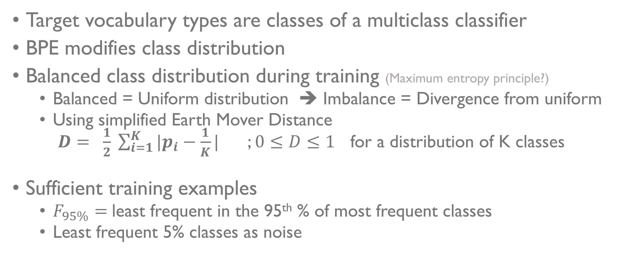
Classifier (C)
Target vocabulary types are classes of a multiclass classifier
BPE modifies class distribution
Balanced class distribution during training (Maximum entropy principle?)
Balanced = Uniform distribution ➔ Imbalance = Divergence from uniform
Using simplified Earth Mover Distance $D= \frac{1}{2} \sum_{i=1}^{K}{|p_{i}−\frac{1}{K}|}$ ; $0≤D≤1$ for a distribution of K classes
Sufficient training examples
$F_{95\%}=$least frequent in the 95th % of most frequent classes
Least frequent 5% classes as noise

Slide 14
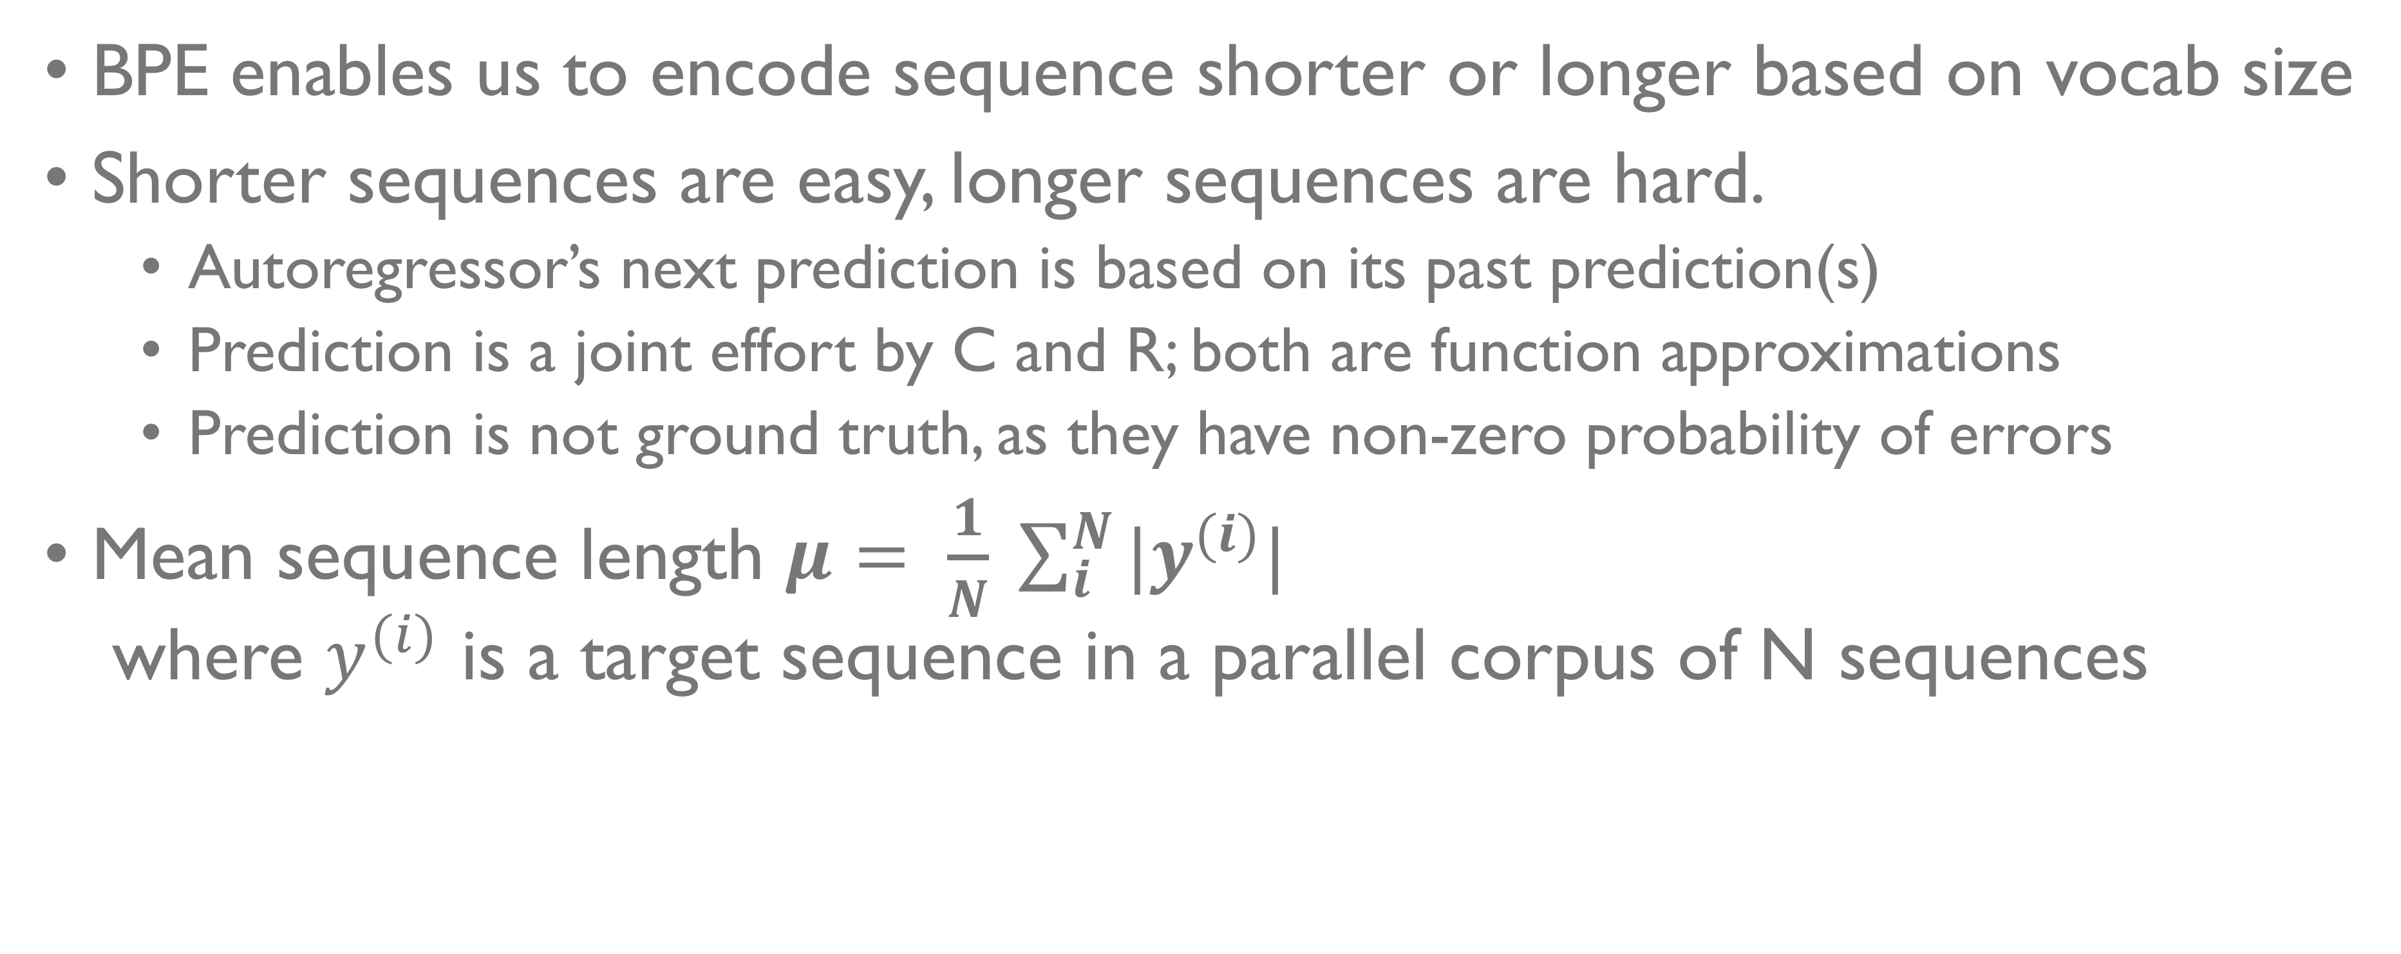
AutoRegressor (R)
BPE enables us to encode sequence shorter or longer based on vocab size
Shorter sequences are easy, longer sequences are hard.
Autoregressor’s next prediction is based on its past prediction(s)
Prediction is a joint effort by C and R; both are function approximations
Prediction is not ground truth, as they have non-zero probability of errors
Mean sequence length $μ= \frac{1}{N} \sum_{i}^{N}{{|y}^{(i)}|}$ where $y^{(i)}$ is a target sequence in a parallel corpus of N sequences

Slide 15
Effect of BPE
As BPE merge operations increase
Sentence length decreases
Class imbalance increases
We need both to be small
We need to find the right trade-off

Slide 16
Heuristic: the largest possible BPE vocabulary such that at least 95% of classes have 100 or more examples in training.

Slide 17
Heuristic: the largest possible BPE vocabulary such that at least 95% of classes have 100 or more examples in training.

Slide 18
Ignore this chart; BLEU scores are too low

Slide 20
Q1: Why are some vocabulary sizes better than others
Autoregressor works best on short sequences
Classifier works best on balanced classes with sufficient Frequency@95%
Use the largest possible BPE vocabulary such that at least 95% of classes have 100 or more examples in training
Q2: Does frequency-based bias on classes exist in NMT? ➔ is there a correlation between class frequency and performance ?

Slide 21
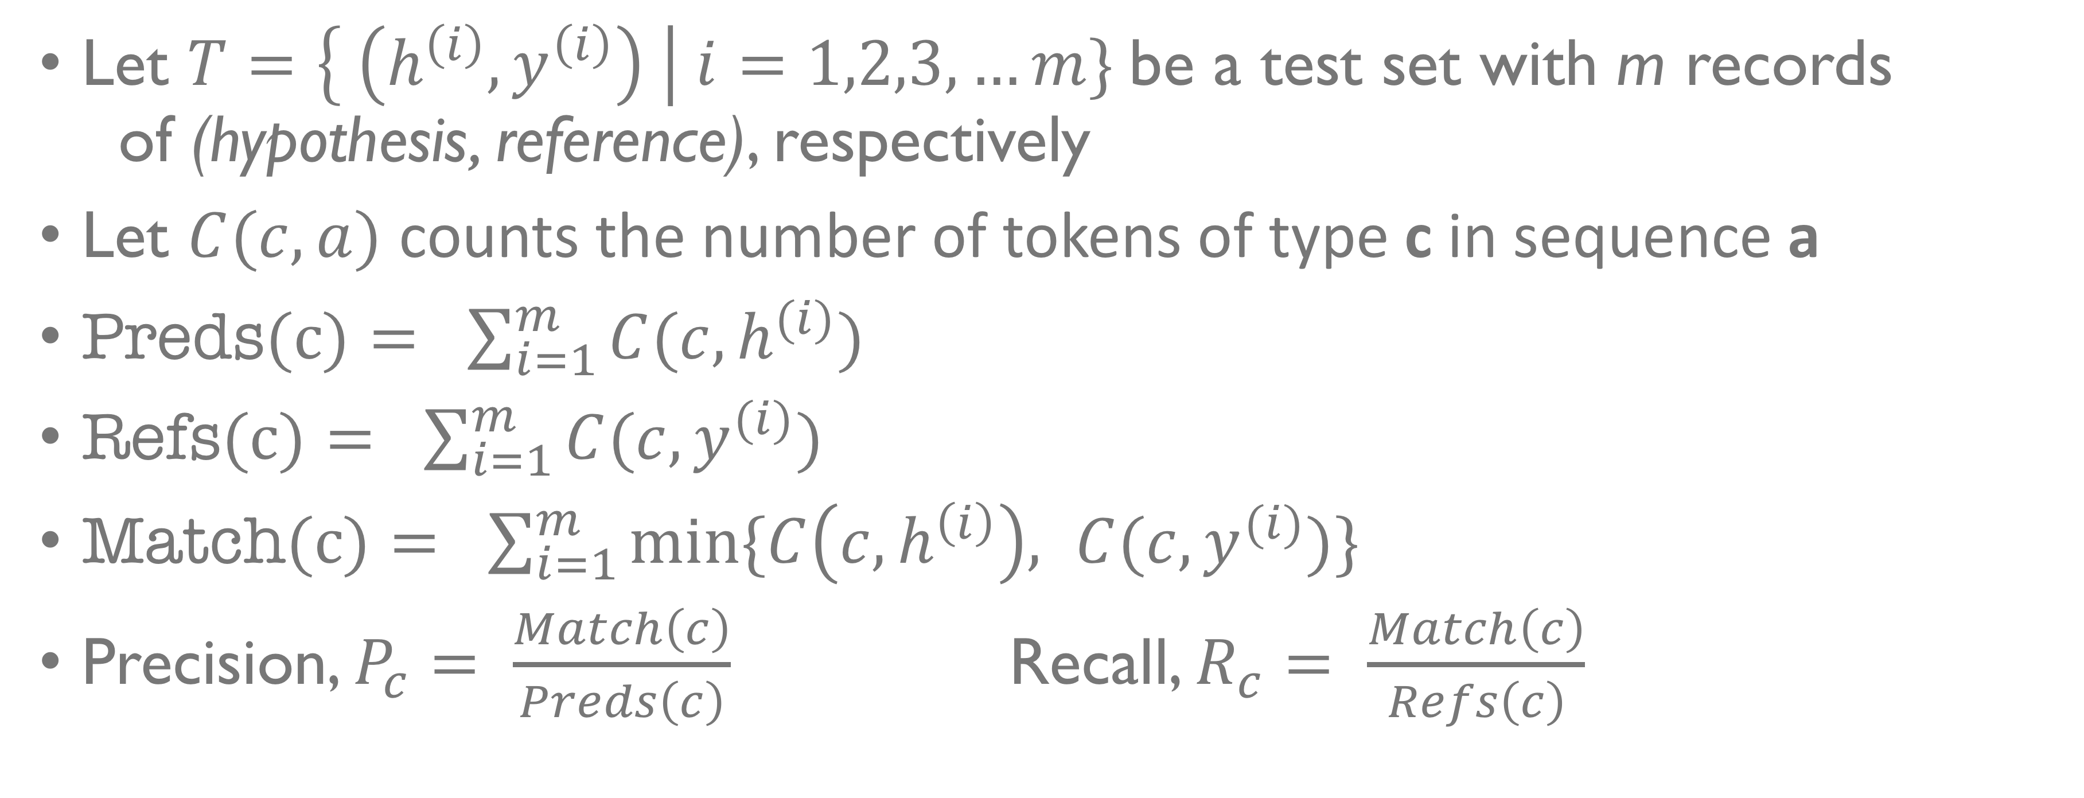
Class Performance
Let $T=\left\{ \left(h^{\left(i\right)},y^{\left(i\right)}\right) \right| i=1,2,3, …m\}$be a test set with m records of (hypothesis, reference), respectively
Let $C(c, a)$ counts the number of tokens of type c in sequence a
$\text{Preds}\text{(}\text{c}\text{)}= \sum_{i=1}^{m}{C(c, h^{(i)})}$
$\text{Refs}\text{(}\text{c}\text{)}= \sum_{i=1}^{m}{C(c, y^{(i)})}$
$\text{Match}\text{(}\text{c}\text{)}= \sum_{i=1}^{m}{min⁡\{C\left(c, h^{\left(i\right)}\right), C(c, y^{(i)})}\}$
Precision, $P_{c}= \frac{Match\left(c\right)}{Preds\left(c\right)}$ Recall, $R_{c}= \frac{Match\left(c\right)}{Refs\left(c\right)}$

Slide 22
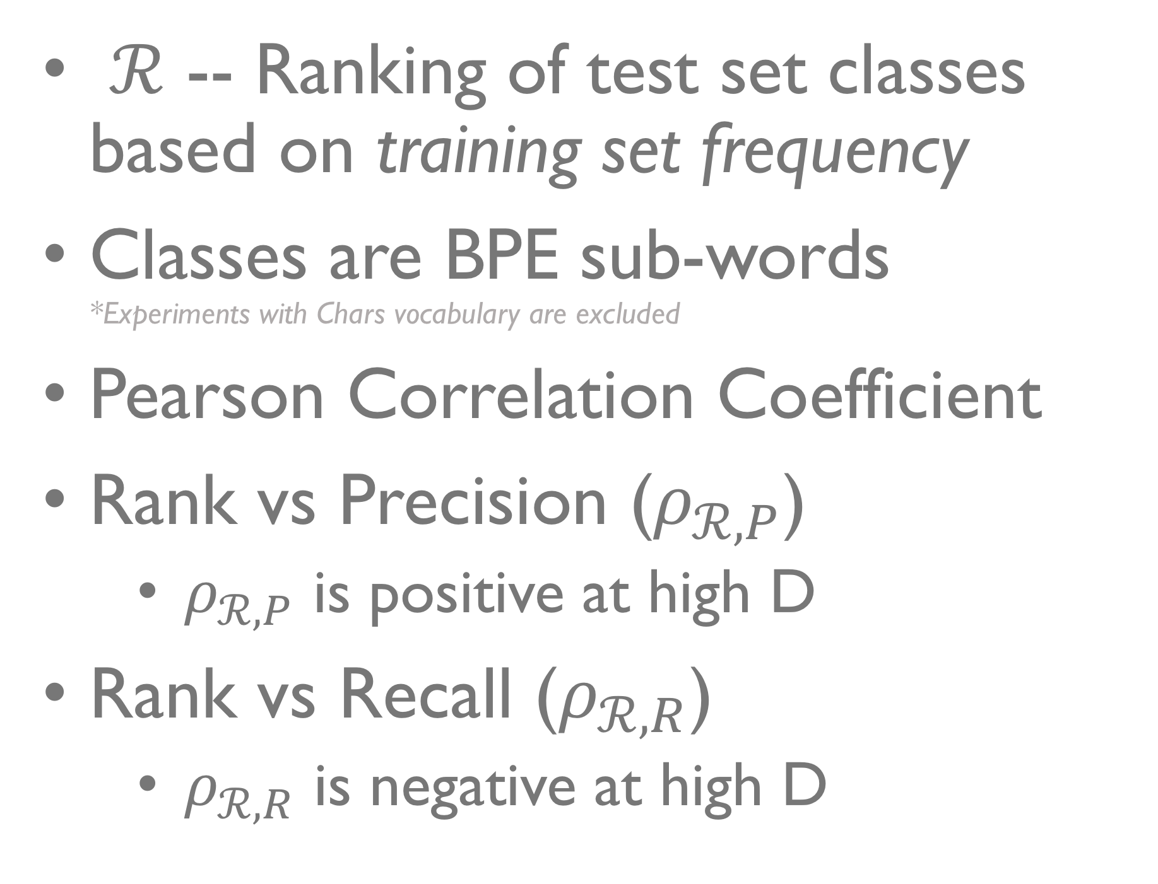
Frequency-based Bias on Class Performance
$ℛ$ -- Ranking of test set classes based on training set frequency
Classes are BPE sub-words *Experiments with Chars vocabulary are excluded
Pearson Correlation Coefficient
Rank vs Precision ($ρ_{ℛ,P}$)
$ρ_{ℛ,P}$ is positive at high D
Rank vs Recall ($ρ_{ℛ,R}$)
$ρ_{ℛ,R}$ is negative at high D

Slide 23
Frequency-based Bias on Class Performance
$ℛ$ -- Ranking of test set classes based on training set frequency
Classes are BPE sub-words *Experiments with Chars vocabulary are excluded
Pearson Correlation Coefficient
Rank vs Precision ($ρ_{ℛ,P}$)
$ρ_{ℛ,P}$ is positive at high D
Rank vs Recall ($ρ_{ℛ,R}$)
$ρ_{ℛ,R}$ is negative at high D

Slide 24
Q1: Why are some vocabulary sizes better than others?
Autoregressor works best on short sequences
Classifier works best on balanced classes with sufficient Frequency@95%
Use the largest possible BPE vocabulary such that at least 95% of classes have 100 or more examples in training
Q2: Does frequency-based bias on classes exist in NMT?
Yes.
Q3: Evaluating NMT as a classifier on imbalanced test sets

Slide 25
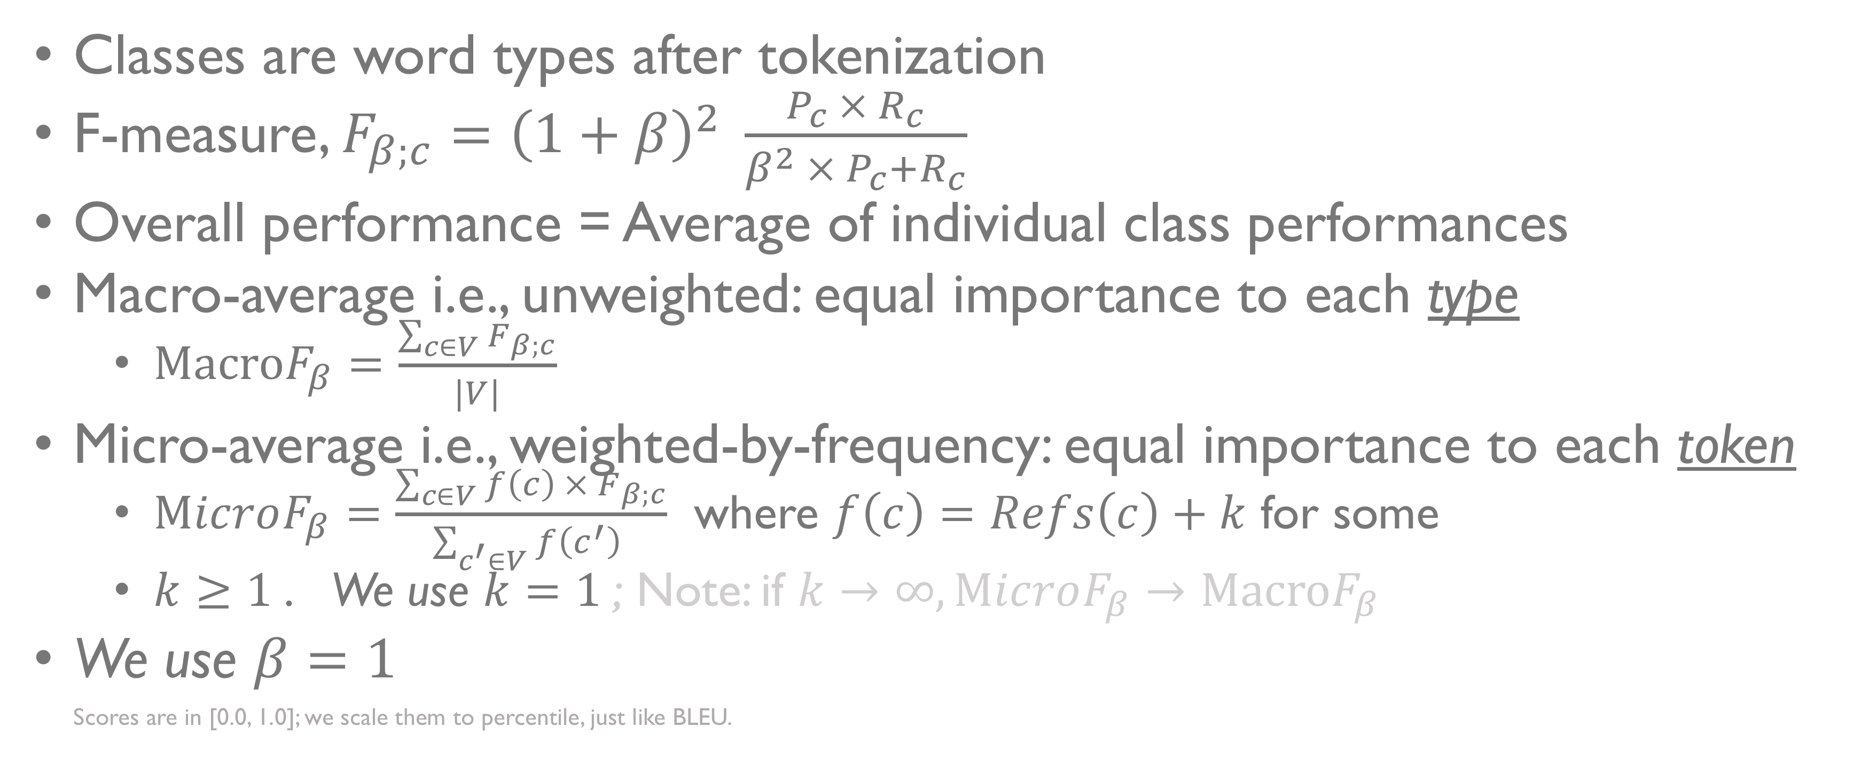
Evaluating MT as a Multiclass-Classifier
Classes are word types after tokenization
F-measure, $F_{β;c}={\left(1+β\right)}^{2} \frac{P_{c} × R_{c}}{β^{2} ×{ P}_{c}+R_{c}}$
Overall performance = Average of individual class performances
Macro-average i.e., unweighted: equal importance to each type
$\text{Macro}F_{β}=\frac{\sum_{c∈V}{F_{β;c}}}{|V|}$
Micro-average i.e., weighted-by-frequency: equal importance to each token
$\text{M}icroF_{β}=\frac{\sum_{c∈V}{f\left(c\right) × F_{β;c}}}{\sum_{c^{′}∈V}{f\left(c^{′}\right) }}$ where $f\left(c\right)=Refs\left(c\right)+k$ for some
$k≥1$. We use $k=1$; Note: if $k→∞, \text{M}icroF_{β}→\text{Macro}F_{β}$
We use $β=1$ Scores are in [0.0, 1.0]; we scale them to percentile, just like BLEU.

Slide 26
Visualization of Micro vs Macro
The ‘the’ type appears 3019 times in DE-EN NewsTest19 test corpus, and zero-recall of ‘the’ results in a losses up to 18.83% BLEU, 9.38% ChrF1, 6.45% MicroF1, and 0.03% MacroF1.

Slide 27
Justification for MacroF1: Overview
➔ Comparing MacroF1 and MicroF1 with BLEU, ChrF1 and BLEURT
WebNLG data-to-text Task: Correlation with Fluency, Grammar, and Semantics; on English only
WMT Metrics Task 2017-2019 Correlation with direct human assessments on tens of languages.
Workshop on CLSSTS 2020 Correlations with downstream CLIR task performance on LT-EN, PS-EN, BG-EN

Slide 28
WebNLG Data-to-Text Evaluation

Slide 29
WMT Metrics

Slide 30
WMT Metrics:

Slide 31
CLIR Task: Pipeline
IR task with queries and docs in different languages
Build a set of MT models; compute MT metrics
For each MT model, translate all source documents to the target language, build an IR model, and measure IR metrics
Find the correlation between the set of MT scores and IR scores. The MT metric having stronger correlation with IR metric(s) is more useful than others.
Repeat this on many languages. We use CLSSTS datasets: LT-EN, PS-EN, BG-EN

Slide 32
CLIR Task: CLSSTS

Slide 33
CLIR Task, CLSSTS Datasets, AQWV

Slide 34
CLIR Task, CLSSTS Datasets, MAP

Slide 35
Summary
Q1: Why are some vocabulary sizes better than others
Autoregressor works best on short sequences
Classifier works best on balanced classes with sufficient Frequency@95%
Use the largest possible BPE vocabulary such that at least 95% of classes have 100 or more examples in training
Q2: Does frequency-based bias on classes exist in NMT?
Yes. We need to investigate it further and resolve it.
Q3: Evaluating NMT as a classifier on imbalanced test sets
MacroF1 captures adequacy better than BLEU, doesn’t have biases like BLEURT
Justification from WebNLG, WMT Metrics, CLSSTS

Slide 36
THANK YOU 🙏🏼

